Slide 1


Switch-Board Application
A project proposal to provide students/staffs/admins/academic-staff a single application to reach out every-other services.

Slide 2

Versions And Approvals
Developed and updated by | Version No. | Date of updating | Reason for updating
As per the current version of the application, we have made some updates from the previous one. So for the due cause we need the approval of the client.
Client Name | Version No. | Date | Signature

Slide 3

The Problem
Students and staffs conduct certain regular activities, such as:
Accessing course materials
Fees payments and result view system
Video-Conferencing platform for attending classes
Placement support and guidance
Report issues / Register Queries
These functionalities available on different platforms which are needed to be accessed from one single portal/application.

Slide 4
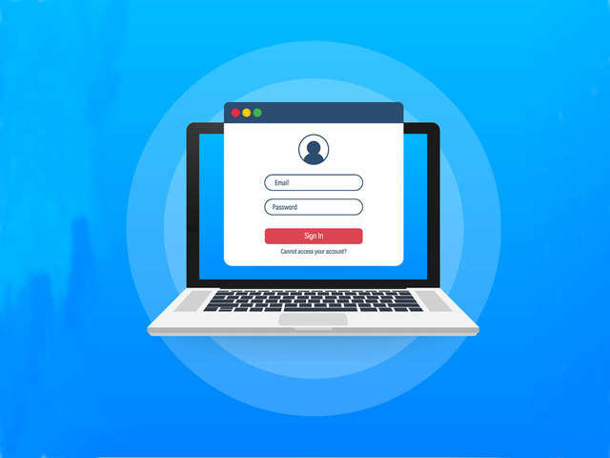
The Solution
A single portal accessible via mobile/desktop devices where the students/staffs and login to access various services from a single application.
One-time login for all platforms.
Description of all other applications.
Authorization based dynamic access.
Responsive & clean UI
Query Form.
Provision to add future updates

Slide 5
Some considerations
1. In future if access to any new service is given to any of the student then that application should be made visible.
2. All the staff will get assess to new application in future when added.
3. One time log-in for all the application to authorized students and staff through simple authentication procedure.

Slide 6

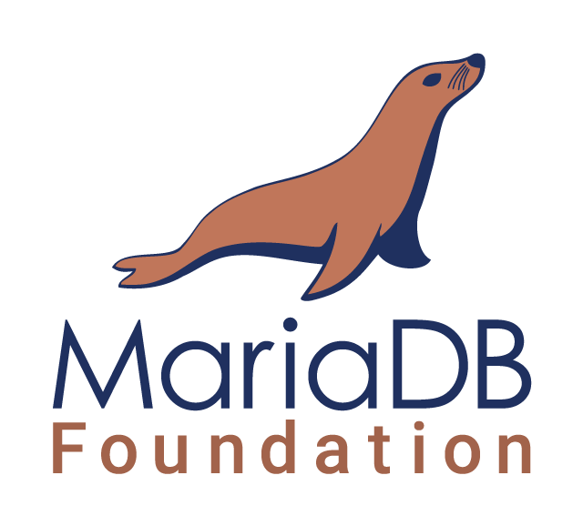
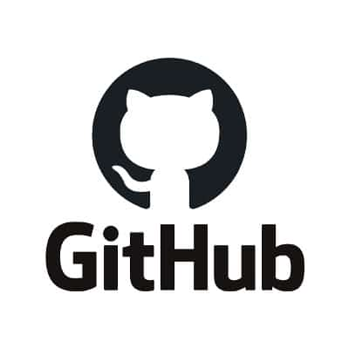
Technology Stack
The application will be developed using the Ruby on Rails MVC framework.
MariaDB being an open-source RDBMS will be used for the purpose of the project
The project will be managed and hosted over GitHub

Slide 7

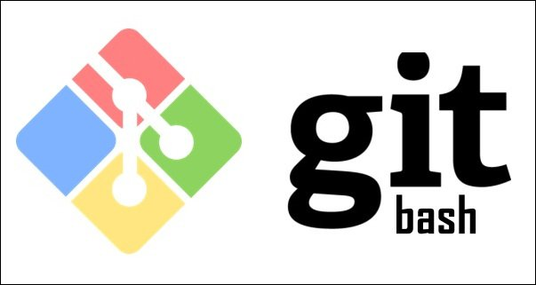

Technology Stack
MongoDB being an open-source DBMS will be used for the purpose of the project
Git Bash is an application for Microsoft Windows environments which provides an emulation layer for a Git command line experience.
Atom is a free and open-source text and source code editor for macOS, Linux, and Microsoft Windows with support for plug-ins written in JavaScript, and embedded Git Control, developed by GitHub. Atom is a desktop application built using web technologies.

Slide 8


